Slide 1
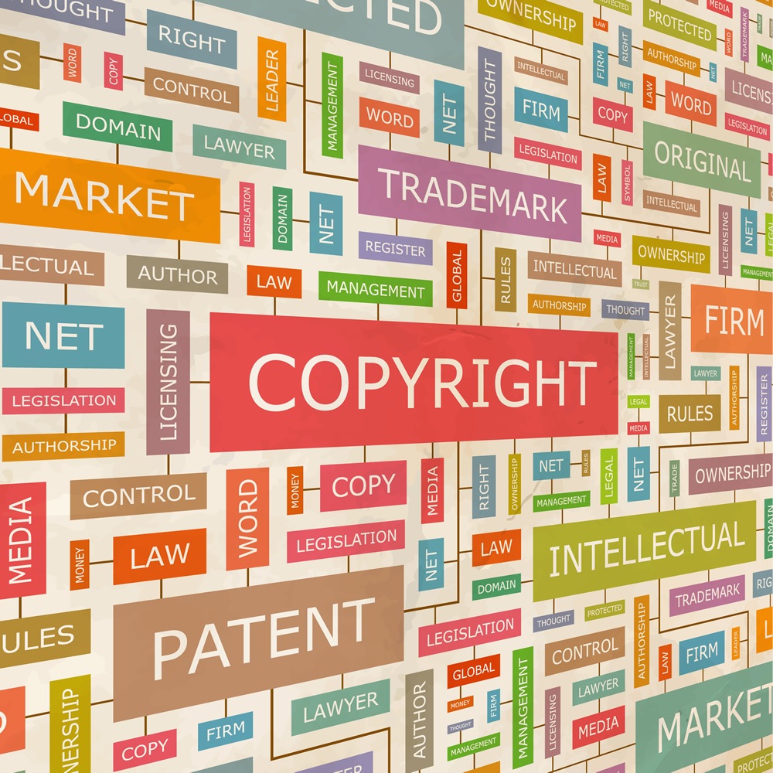
Mark the Spot: Trademarks Talk
Dr. Rahul Taneja
Registered Patent & Trademark Agents
Scientist
Patent Information Centre/
Haryana State Council for Science & Technology
Directorate of Science & Technology
Government of Haryana, Panchkula (Haryana)
Email id: drrahultaneja@gmail.com,
M: 090171-80265

Slide 3
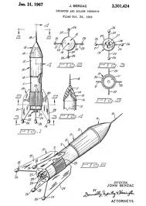
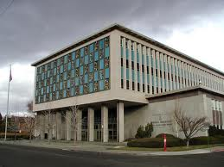
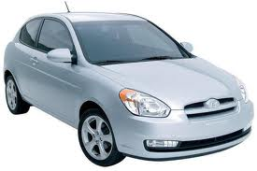
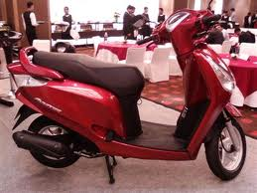
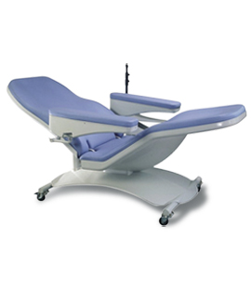
Property
MODERN CONCEPT OF OWNERSHIP
Tangible
Intangible (Intellectual)

Slide 4
Ownership (Rights)
Exclusive Rights
Recognized by Law
Subject to Certain Restrictions
Enjoy Occupy
Possess Rent
Sell Use
Give away Destroy

Slide 5
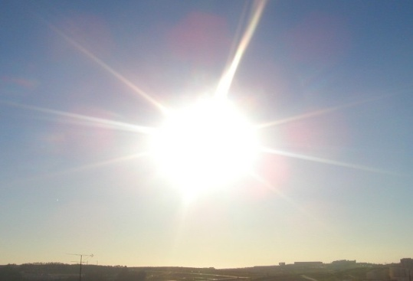
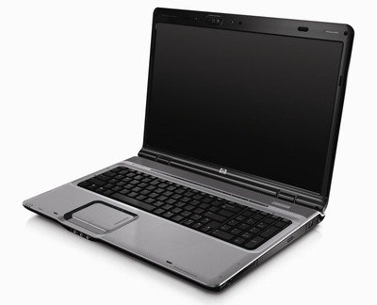
Property
Anything that is owned by a person or entity
?
Air
Sunlight

Slide 6
Intellectual Property
“Intellectual Property shall include the rights relating to
literary, artistic and scientific works,
performances of performing artists, phonograms, and broadcasts,
inventions in all fields of human endeavor
scientific discoveries
Industrial designs
trademarks, service marks and commercial names and designations
protection against unfair competition
and all other rights resulting from intellectual activity in the industrial, scientific, literary or artistic fields.”
(WIPO Convention)

Slide 7
Major Intellectual Properties
Industrial Property
Patents
Industrial Designs
Copyright
Copyright
Trademarks
Geographical Indications
Layout Designs
Trade Secrets
Protection of New Plant Varieties

Slide 8
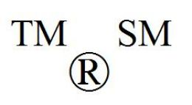
Trademarks

Slide 9
Trademark
A name of an enterprise or a mark capable of being represented graphically, distinguishing the goods or services of one person from those of others e. g., LUX, Godrej, TVS ,Telco, 555, APPLE.
Trade Mark can be -
sign , words, letters, numbers,
drawings, pictures, emblem,
colours or combination of colours,
shape of goods,
graphic representation or packaging or
any combination of the above
as applied to an article or a product.

Slide 10
Registration of Trade Mark
Trade Marks are registered by national trade mark registries and are valid in that country.
Registration is made after examination and publication.
Period of registration is for 10 years but can be renewed indefinitely.
rahulipr@hotmail.com
10

Slide 11
What is protected and = What’s not?
Right to use TM in relation to goods/ services as registered are protected (If TM consists of several parts, protection is for TM as a whole)
State Emblems, Official Hallmarks, Emblems of Intergovernmental Organizations cannot be used as TM.

Slide 12
What is Branding
Branding allows a company to differentiate its products and services from the competition by creating a bond with its customers in order to create customer loyalty.
This way, a company can have a position in the marketplace that is much more difficult for the competition to poach. A satisfied customer may leave. But a loyal customer is more likely to stay.
Notes:
Branding and IP are closely linked from a business perspective. Enterprises today know the value of branding.
The ultimate aim of an enterprise should be to create a loyal customer, because a loyal customer insists on buying a certain product or service even if the price is higher than that of the competition - and That is the type of customer an enterprise can gain through branding

Slide 13
Trade Marks Classification (Some of the classes are…………….)
Class 1 Chemicals
Class 3 Soaps, Detergents
Class 5 Medicines
Class 7 Machine Tools
Class 9 Electronic Components
Class 25 Garments
Class 30 Food Items
Class 35 Trading
Class 41 Educational Services
Class 43 Restaurants, Hotel Services
Total Classes 45 in which
For Product Trademark 34
And For Service Trademark 11

Slide 14
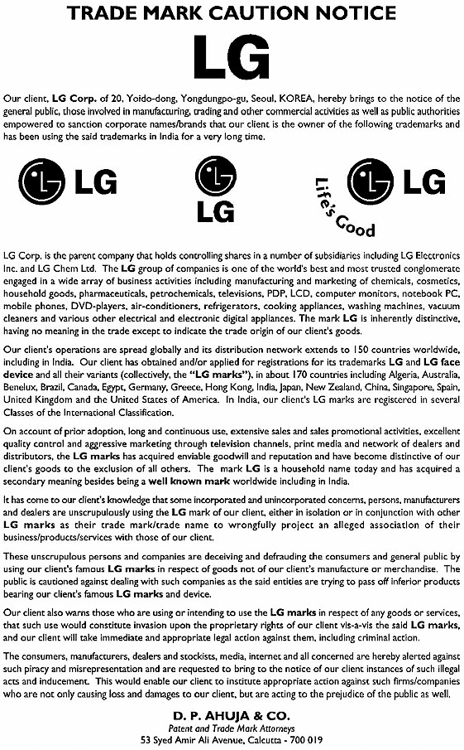
v

Slide 20
Means
Has value, reputation
It is owned by Bisleri International
It is their property as it has characteristic of a property

Slide 21
Identify the symbol

Slide 22
The Nike’s case
Reflects the popularity of a well-known TM
The “Swoosh” is the well known symbol of Nike
Originally Nike’s logo included also the shoemaker’s name
At the end of the nineties, the Nike’s name disappeared
The swoosh remained as the main identification symbol of the shoemaker
Today there is no need to include the brand into this logo since the recognition of a simple swoosh automatically brings our attention to Nike

Slide 23
The Function of a Trademark
Allows companies to differentiate their products
Ensures consumers can distinguish between products and ultimately develop brand loyalty
Notes:
Trademarks play a pivotal role in the branding and marketing strategies of companies. TM in fact contribute to defining the image and reputation of a company’s product in the eyes of a consumer.

Slide 24
The Value of a Trademark
A marketing tool
Source of revenue through licensing
Crucial component of franchising agreements
May be useful for obtaining finance
A valuable business asset

Slide 25
Trademark Protection > Registration =
Exclusive rights prevent others from marketing products under same or confusingly similar mark
Secures investment in marketing effort
Promotes customer loyalty/ reputation / image of company
Provides coverage in relevant markets where business operates
Registered marks may be licensed or basis franchising agreements

Slide 26
Scope of Rights
The exclusive right to use the mark
The right to prevent others from using an identical or similar mark for identical or similar goods or services
The right to prevent others form using an identical or similar mark for dissimilar goods or services

Slide 27
Kinds of Trademarks
Trademarks | to distinguish goods
Service Marks | to Distinguish Service
Collective Marks | to distinguish goods or services by members of an association
Certification Marks | to distinguish goods or services certified by a certifying authority
Well Known marks | very famous in the market and as a result benefit from stronger protection

Slide 28
6:00 AM | Ajanta, Citizen, I-Phone, Samsung
6:30 AM | Colgate, Close-up
7:30 AM | Nescafe, Taj Mahal, Red Label, Taaza
8:00 AM | Dettol, Lifebuoy, Lux, Cinthol
8:30 AM | Kissan Fruit Jam, Maggi Tomato Ketchup, Kellogs
9:00 AM | Maruti Suzuki, Hero Honda, TVS, Toyota
9:30 AM | IBM, Lenevo, HCL, HP
10:30 AM | Yahoo, rediff, gmail, hotmail
11:30 AM | Canon fax, Intercom
1:30 PM | Mc Donald's, Dominos, Pizza Hut, Sagar Ratna
6:00 PM | PVR, Big Cinema, V Mart, Easy Day
8:00 PM | Sony, Star Plus, Discovery, CNN
10:00 PM | Good Night, All- Out , JET

Slide 29
Pizza please…….

Slide 30
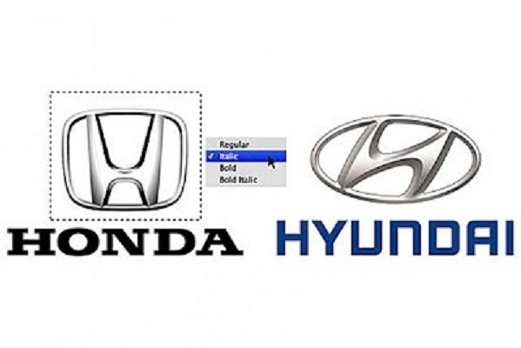

Slide 32
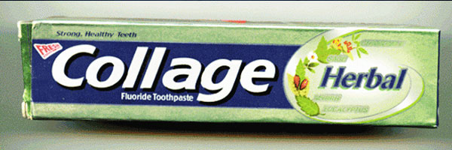
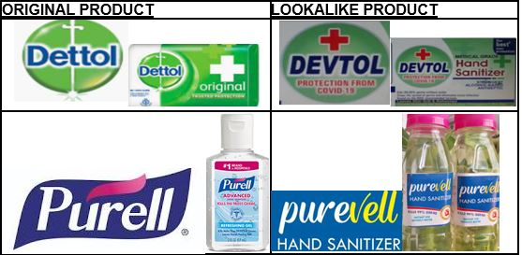

Slide 33
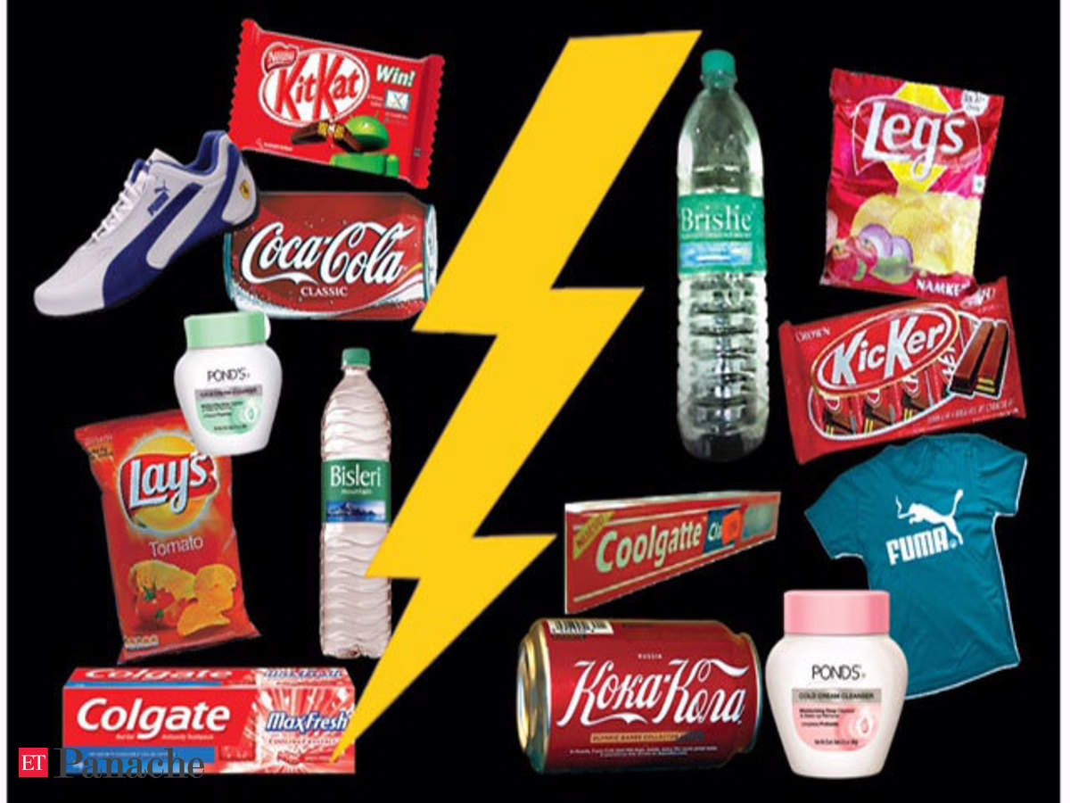

Slide 34
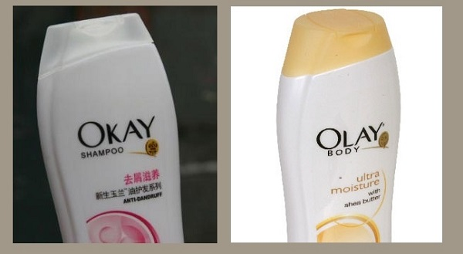

Slide 35
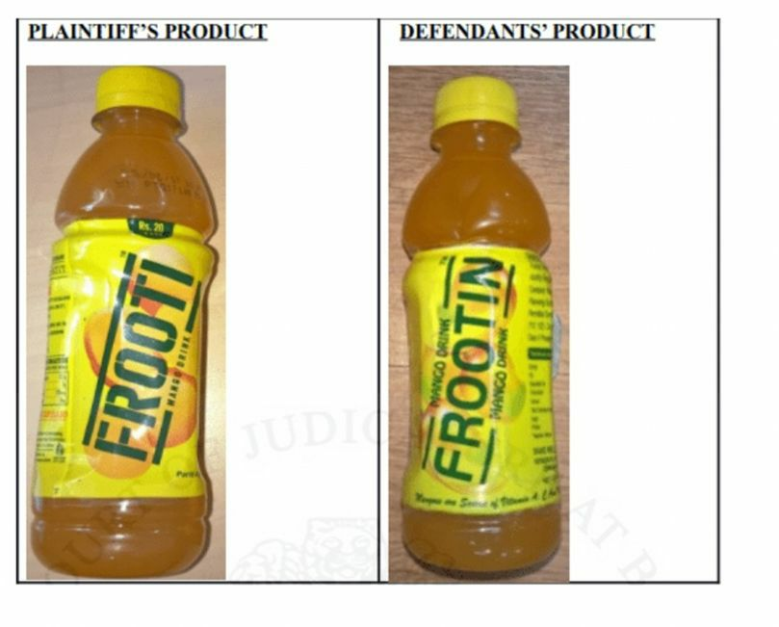

Slide 36
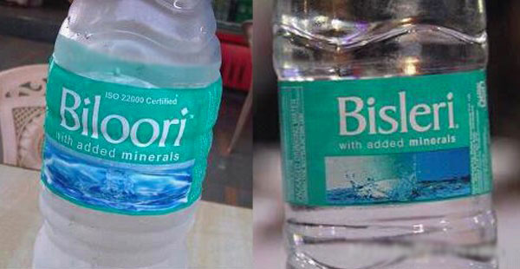

Slide 37
Same brand name Different molecule different companies

Slide 38
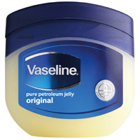
Vaseline
Vasaline
New Vasoline
Blueline Vasoline
Vasotoline
Blue Star Vavoline
With Similar Color Combination

Slide 39
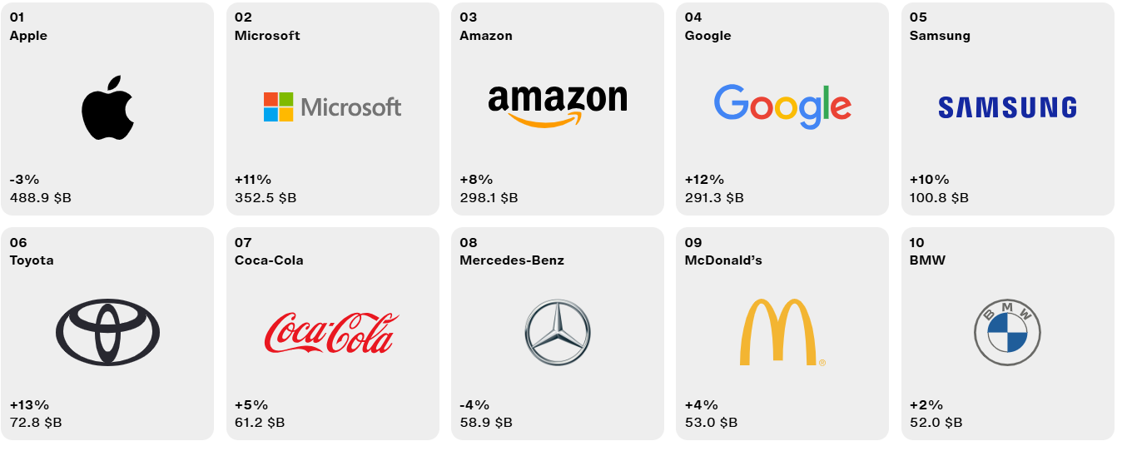
Best Global Brands 2024
Source: Interbrand.com 2025

Slide 40
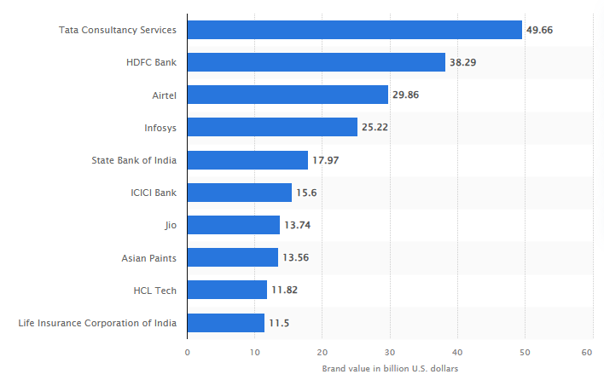
Most valuable brands in India in 2024,
by brand value (in billion U.S. dollars)

Slide 41
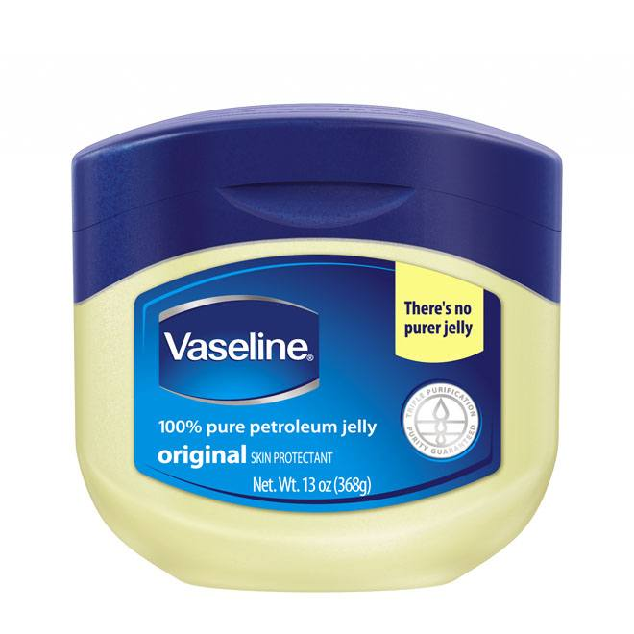
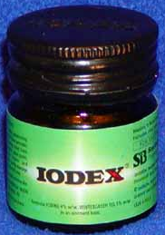
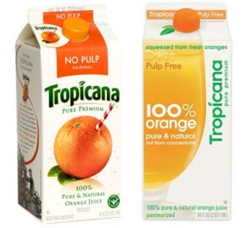
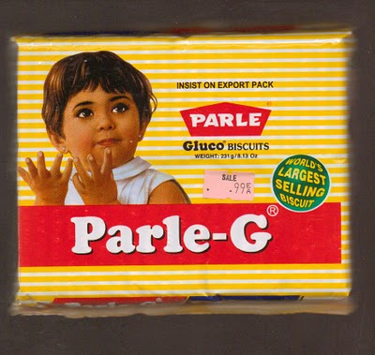
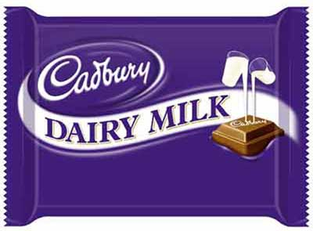
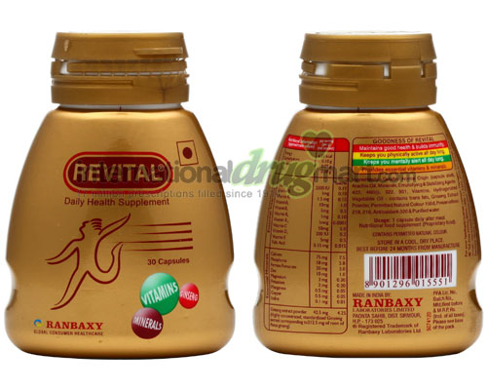
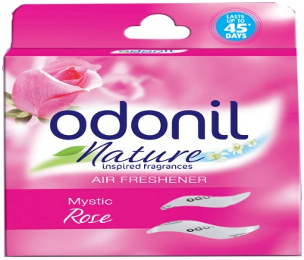
Copyright- Trade Dress Protection

Slide 42
Administrative set up
Department of Industrial Policy & Promotion, Ministry of Commerce & Industry
Controller General of Patents, Designs & Trademarks (CGPDTM)
Delhi
Mumbai
Trademarks Registry (TMR)
Chennai
Kolkata
Ahmedabad

Slide 43
Maharashtra, Madhya Pradesh & Goa
Mumbai Trade mark Registry
J
U
R
I
S
D
I
C
T
I
O
N
Gujarat, Rajasthan & the Union Territories of Daman, Diu, Dadra & Nagar Haveli
Ahmedabad Trade mark Registry
Andhra Pradesh, Kerala, Tamil Nadu, Karnataka, Pandichery & Lakshadweep
Chennai Trade mark Registry
Arunachal Pradesh, Assam, Bihar, orissa, West Bengal, Manipur, Mizoram, Meghalaya, Sikkim, Tripura, Nagaland, Andaman & Nikobor
Kolkata Trade mark Registry
Jammu & Kashmir, Punjab, Haryana, U.P., Himachal Pradesh, Delhi & Chandigarh
Delhi Trade mark Registry

Slide 44
How to select a Trade Mark
if it is a word it should be easy to speak, spell and remember.
SONY, TATA, BATA
The best Trade marks are invented words or coined
KODAK, DALDA
Mark should not be Geographical name
LUDHIANA STEEL, CHANDIGARH SALT
Avoid adopting word describing the quality of goods/ services
BEST, PERFECT, SUPER, QUALITY

Slide 45
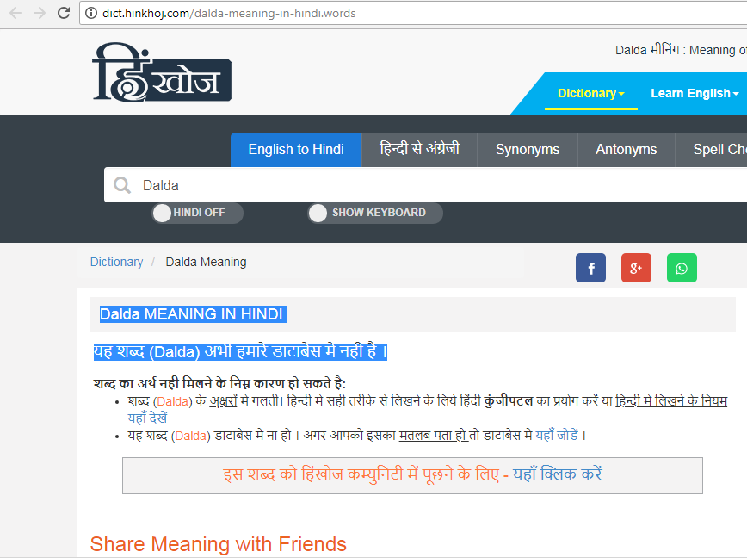

Slide 46
Protecting at Home and Abroad
The national route
Each country where you seek protection
The regional route
Countries members of a regional trademark system: African Regional Industrial Property Office; Benelux TM office; Office for Harmonization of the Internal Market of the EU; Organisation Africaine de la Propriété Intellectuelle
The international route
The Madrid Union currently has 115 members, covering 131 countries. These members represent more than 80% of world trade, with potential for expansion as membership grows.
Notes:
Remember that trademark registration is territorial - if you have registered in your country it does not mean that your TM is protected abroad.
.
.
.
.
International Route: if a country is member of the Madrid Union for the registration of TM administered by WIPO (check the status of country in question where presentation is being given): advantage is as a member can apply to all other member countries with one application 1 language 1 set of fees. Renewal also single procedure.

Slide 47
Madrid Protocol
India joined the Madrid Protocol on July 8, 2013.
This allows Indian trademark owners to file a single international application with the World Intellectual Property Organization (WIPO) to obtain trademark protection in multiple countries.
The Madrid system streamlines the process and reduces costs compared to filing separate applications in each country.

Slide 48
Benefits of Madrid System
Key aspects of the Madrid Protocol:
Simplified Trademark Registration: Indian businesses can now register their trademarks in multiple countries through a single application, making the process more cost-effective and less time-consuming.
Centralized Management: The Madrid system provides a centralized platform for managing trademark applications, renewals, and other changes, further simplifying the process.
Increased Global Reach: India's membership in the Madrid Protocol allows its businesses to expand their reach into international markets more easily.
Benefits for SMEs: The Madrid system is particularly beneficial for small and medium-sized enterprises (SMEs) that may lack the resources to file separate trademark applications in multiple countries.
Harmonization with International Standards: Joining the Madrid Protocol aligns India's trademark system with international standards, promoting intellectual property harmonization.

Slide 49
Trademark Registration Process
Trademark Search
Application (TM filing)
Objection
Acceptance
Journal Acceptance
Opposition
Trademark Registration

Slide 50
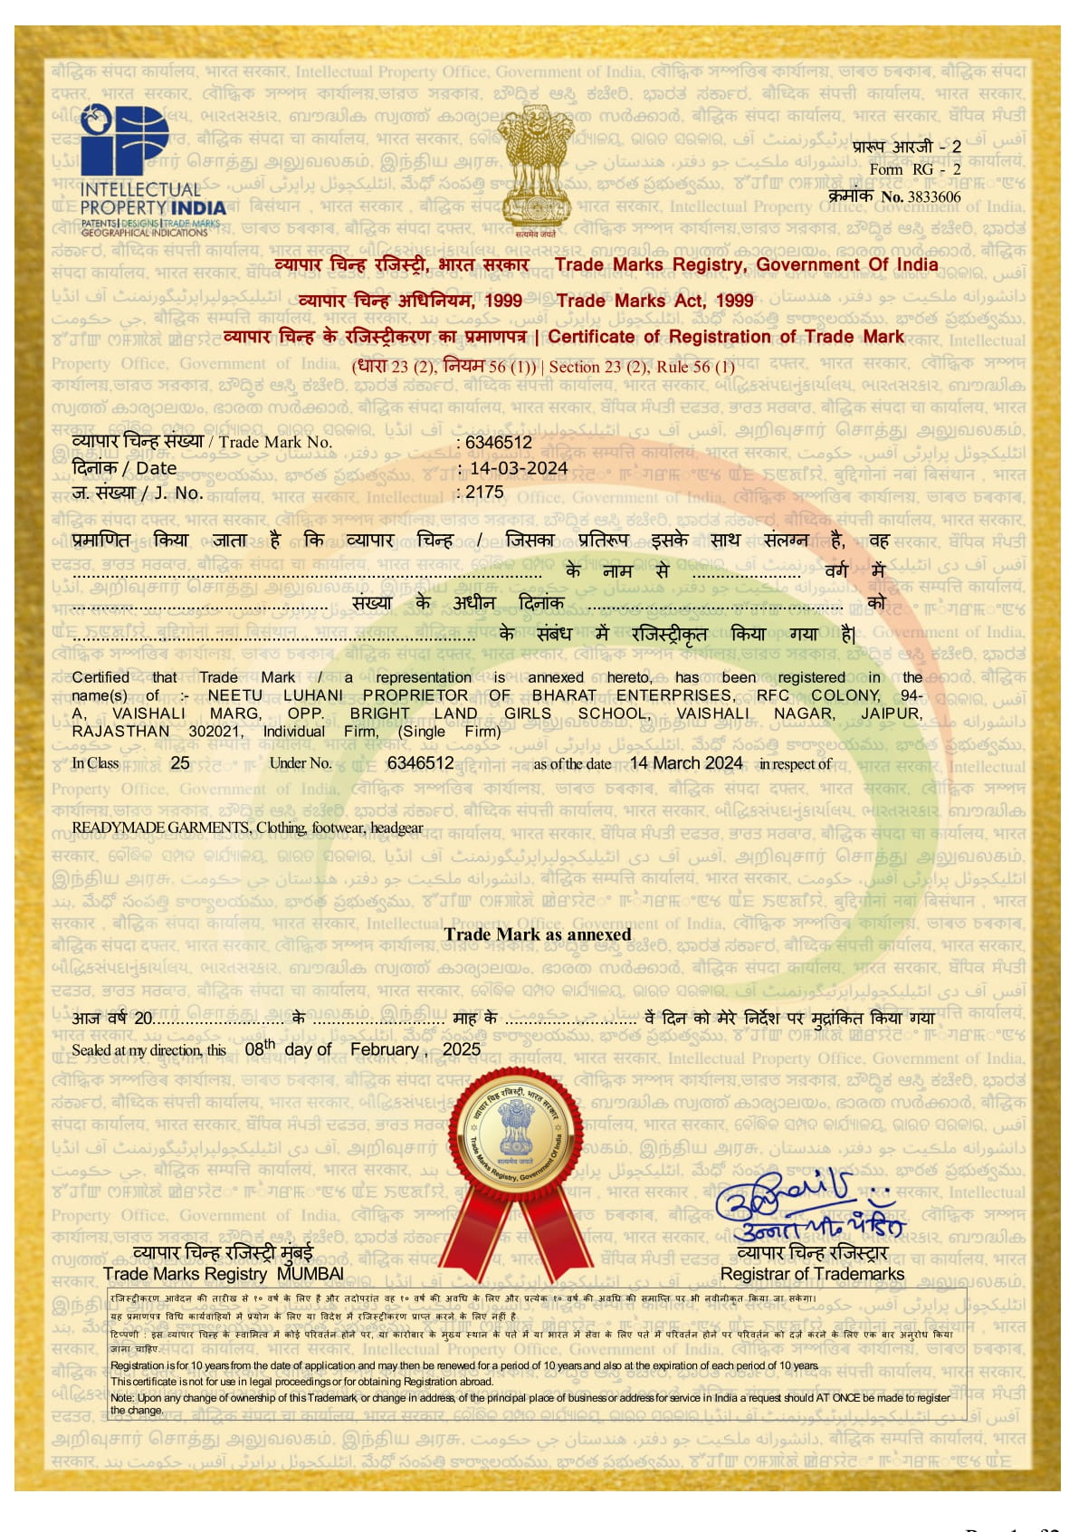
Trademark Registration Certificate

Slide 51
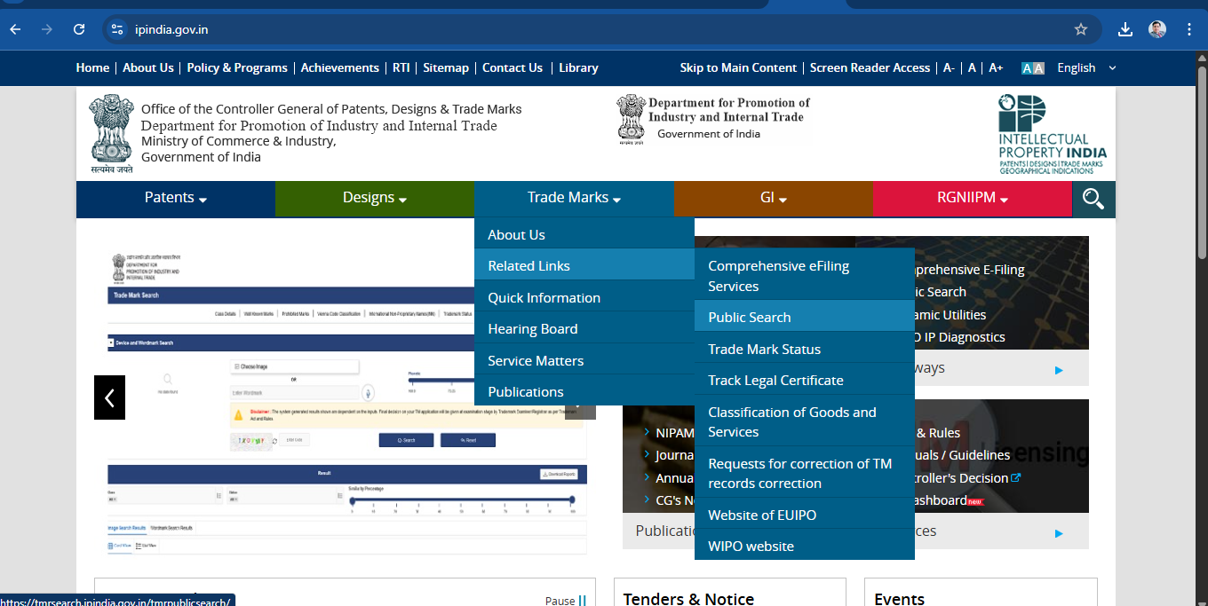

Slide 52
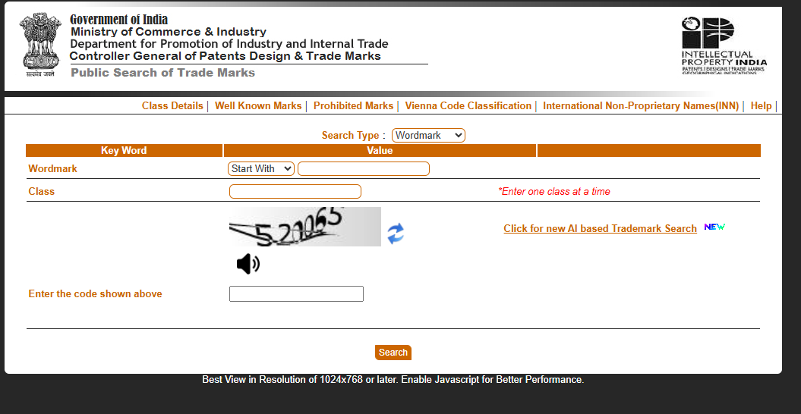

Slide 53
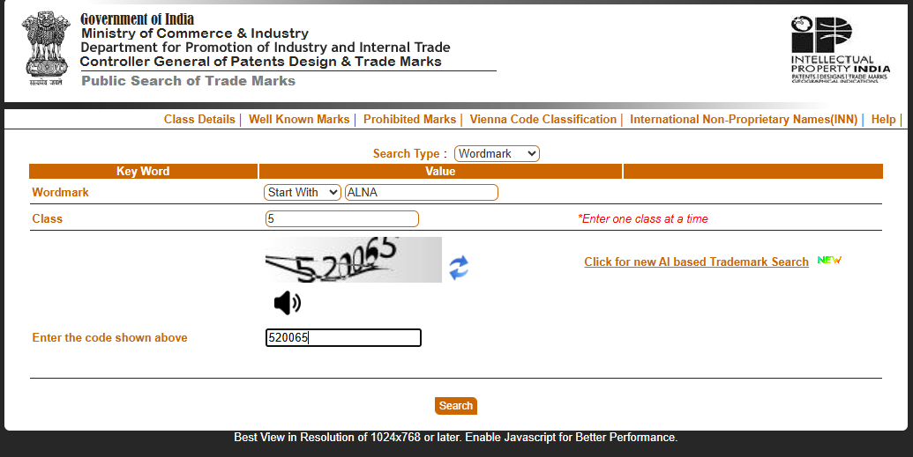

Slide 54
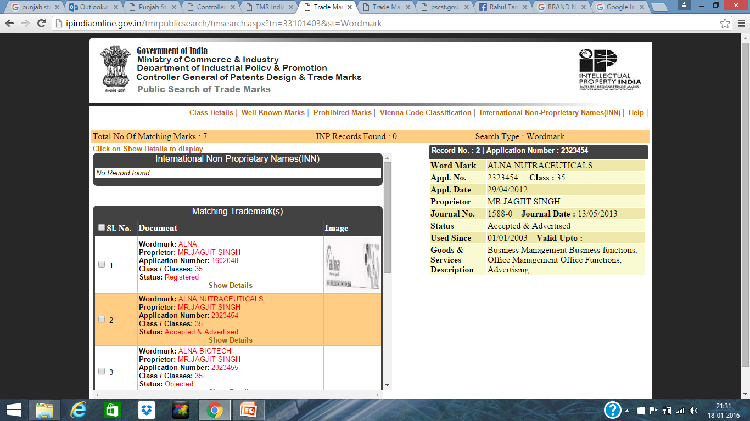

Slide 56
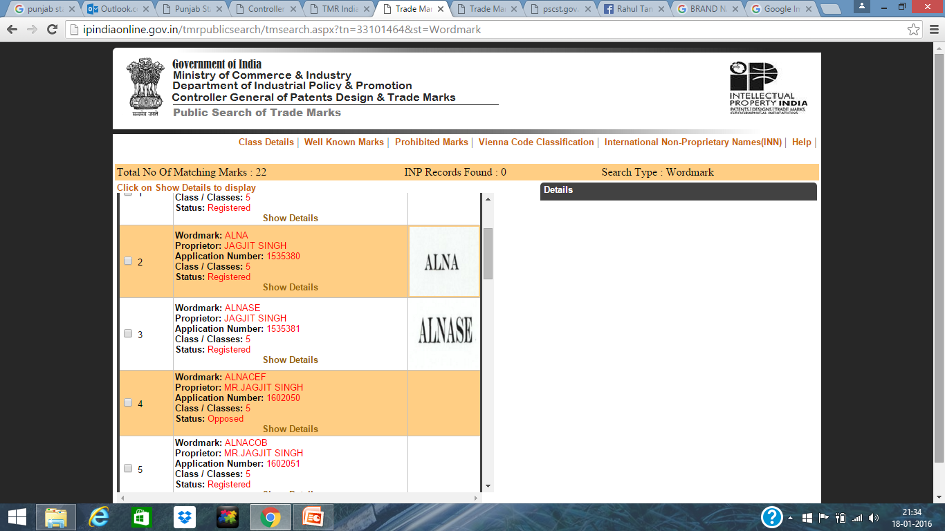

Slide 57
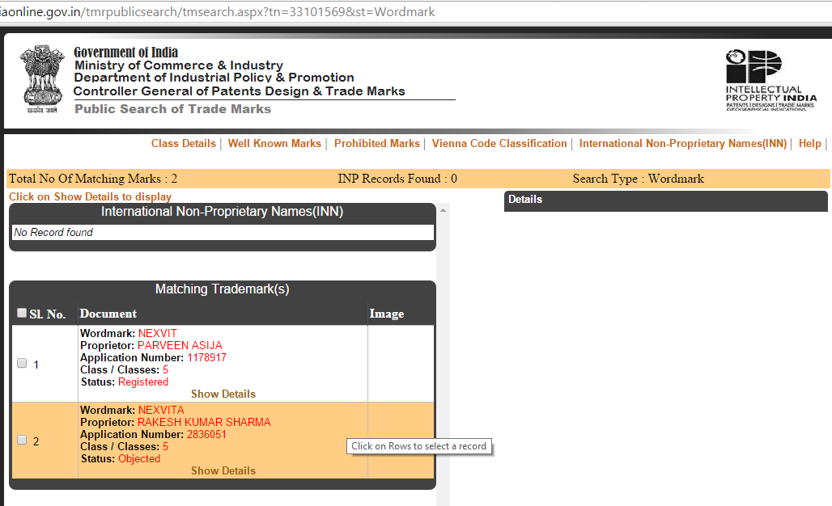
Comparison of Brands NEXVIT V/s NEXVITA

Slide 58
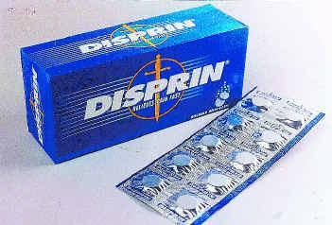
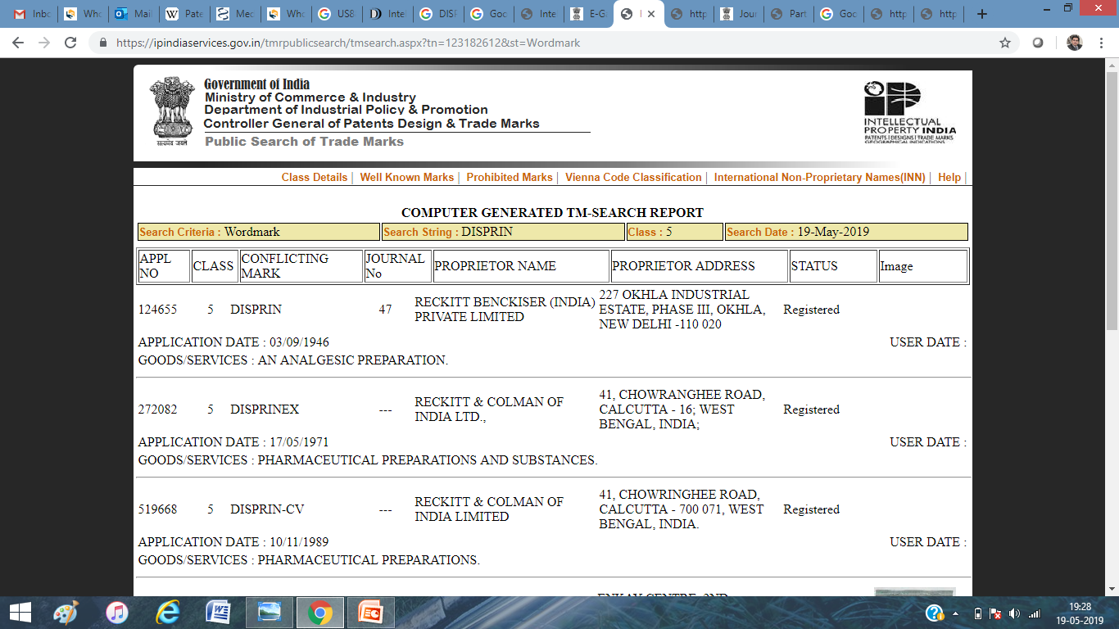
Trademark for Medicinal, Pharmaceutical, Ayurvedic, Dietary Supplements. Class 5

Slide 59
Medical Device/ Medical Instruments: Class 10

Slide 61
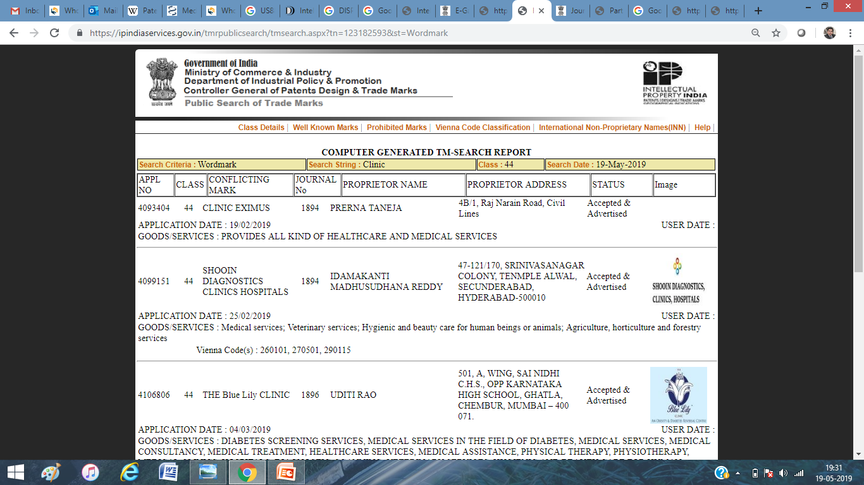
Hospital, Clinics, Beauty/Skin Care
Centre. Class 44

Slide 62
Forms and Fees
Entry No | On what payable | Amount in INR. |  | Corresponding Form Number
 |  | For Physical filing (Offline) | For E-filing (Online)
1 | Application for registration of a trademark /collective Marks / Certification Mark / Series of trademark for specification of goods or services included in one or more than one classes. |  |  | TM-A
 | Where the applicant is an Individual / Startup/Small Enterprise | 5,000 | 4,500
 | In all other cases (Note: Fee is for each class and for each mark ) | 10,000 | 9,000
2 | On a notice of opposition under section 21(1), 64, 66 or 73 or application for rectification of register under section 47 to 57, 68, 77 or application under rule 99, 103, 135,140 or On application under section 25 of Geographical Indication of Goods (Regulations and Protection) Act, 1999 to invalidate a trademark or counter statement related thereto. (Note: Fee is for each class opposed or counterstatement filed) | 3,000 | 2,700 | TM-O

Slide 63
Forms and Fees
3 | For renewal of registration of a trademark under section 25 for each class | 10,000 | 9,000 | TM-R (41 KB)
 |  | Application for renewal with surcharge of registration of a Trademarks under section 25 (3) for each class | 5,000 Plus renewal fee applicable under entry 3 | 4,500 Plus renewal fee applicable under entry 3
 |  | Application for renewal with surcharge/ restoration and renewal of a Trademarks under section 25 (3), 25 (4) for each class | 10,000 Plus renewal fee applicable under entry 3 | 9,000 Plus renewal fee applicable under entry 3
4 | On application under section 45 to register a subsequent proprietor in case of assignment or transfer for each trademark | 10,000 | 9,000 | TM-P (64 KB)
 |  | On application for: Certificate of the Registrar under section 40(2), or For approval of the Registrar under section 41, or Direction of the Registrar for advertisement of Assignment without goodwill under section 42, or Add or alter a registered trademarkunder section 59(1) for each trademark, or Conversion of specification under Section 60 for each trademark. | 3,000 | 2,700
 |  | On application for: Extension of time for applying for direction under section 42 for advertisement of assignment without goodwill, or Extension of time for registering a company as subsequent proprietor of trademarks under section 46(4),or Consent of Registrar to the assignment or transmission of a certification trademark under section 43, or Change a name and / or description of a registered proprietor or a registered user of a trademark under section 58 for each trademark. | 2,000 | 1,800

Slide 64
Geographical Indications

Slide 65
What are Geographical Indications
An indication used to identify agricultural, natural or manufactured goods originating from a definite territory in India.
It should have a special quality or characteristics or reputation based upon the climatic or production characteristics unique to the geographical location.
This is a collective right as opposed to a private right
Any association of persons, producers, organization established by or under the law can apply representing & protecting the interests of the producers.
Identifies the product as originating in a country or region thereof
Whose quality, reputation or other characteristics are attributable to its geographical origin
BASMATI, DARJEELING TEA, CHAMPAGNE, SCOTCH WHISKY, HAVANA CIGARS, ALPHONSO MANGOES

Slide 66
Geographical Indication
Some facts about registration-
It is an indication
It originates from a definite geographical territory.
It is used to identify agricultural, natural or manufactured goods
Can be renewed continuously for further period of 10 years at each subsequent renewals
If not renewed it is liable to be removed from the register
Can not be assigned, transmitted, licensed, pledged, mortgaged

Slide 68
Geographical indications and trademarks
GIs are closely related to trademarks; both indicate product origin
GIs and trademarks differ in two ways:
A trademark belongs to a particular company; it distinguishes that company’s products.
GIs are shared by all producers in the region identified by the GI.
GIs attach to a location; trademarks don’t.

Slide 69
Thank you for kind Attention
QUESTIONS?
For further information please contact at:
Dr. Rahul Taneja
Scientist
Registered Patent & Trademark Agent
Patent Information Centre
Haryana State Council for Science & Technology
Directorate of Science & Technology
Government of Haryana, Bays 35-38, Sector – 2, Panchkula (Haryana)
E-mail: drrahultaneja@gmail.com
Mobile: 090171-80265
rahulipr
rahulipr
@rahultaneja64

